Slide 1
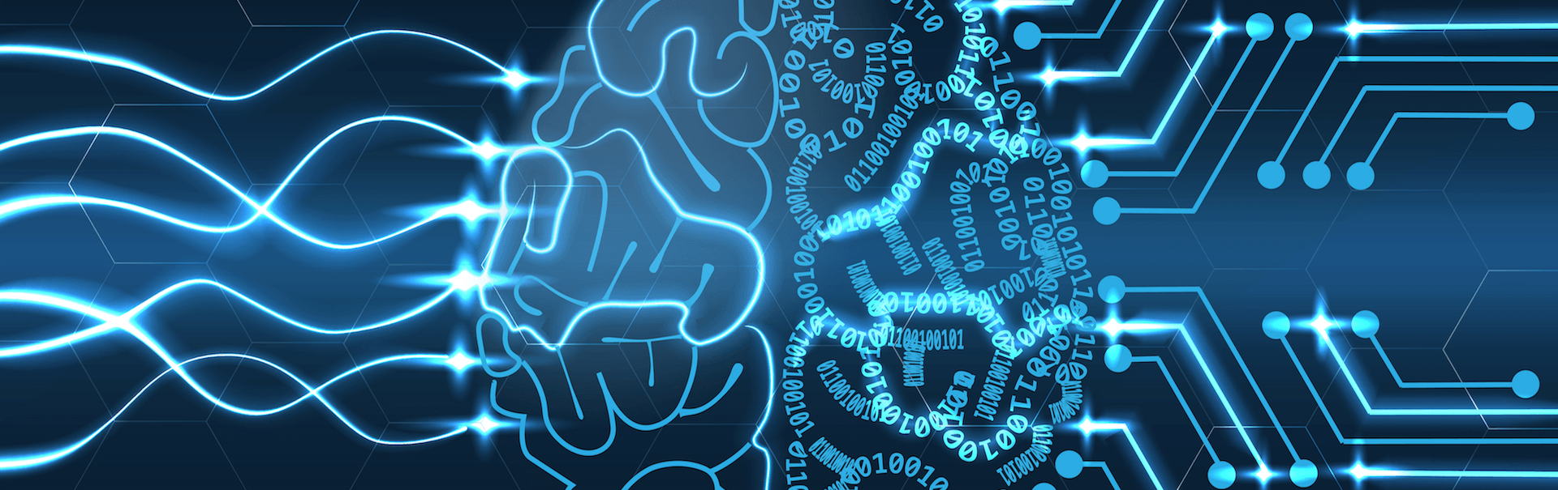
Artist Identification
using Convolutional Neural Networks

Slide 2
Tech Requirements
Dataset
Data Augmentation
CNN
Conclusions

Slide 3
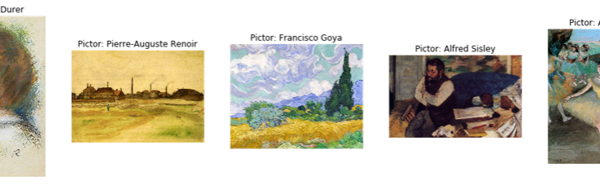
Random samples from dataset
Dimensions are between: Height: 213 4096 Width: 226 3826
Kaggle: best-artworks-of-all-time

Slide 4
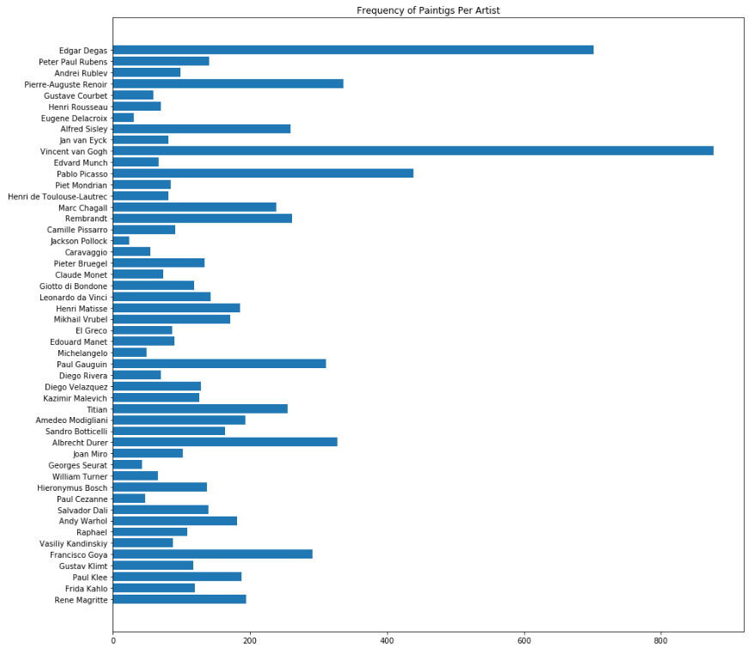
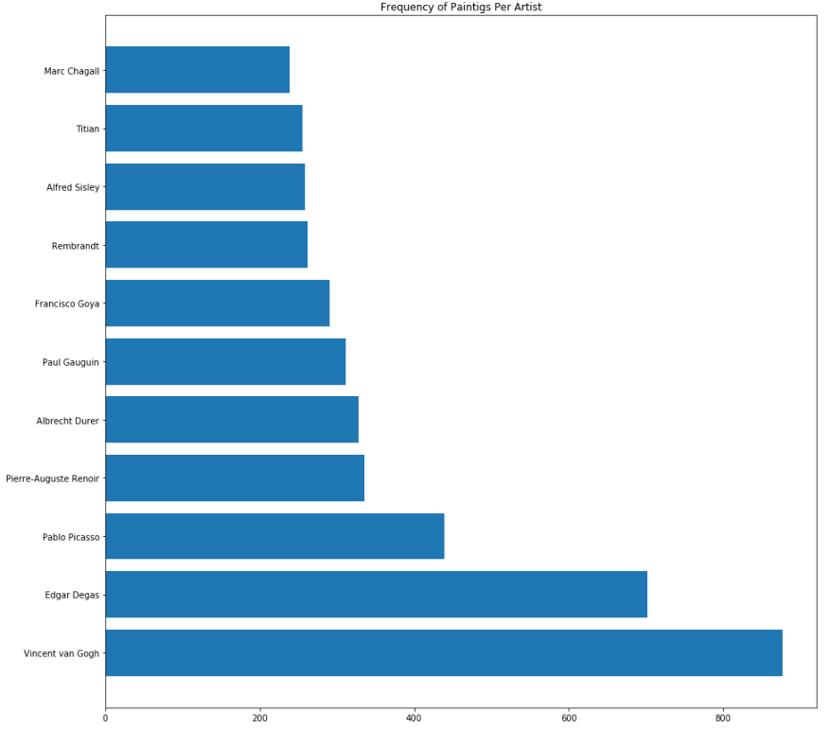
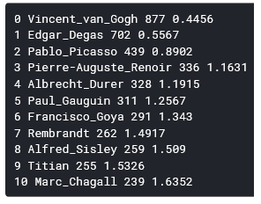
DATA DISTRIBUTION
POST FILTER DISTRIBUTION
INITIAL DISTRIBUTION

Slide 5
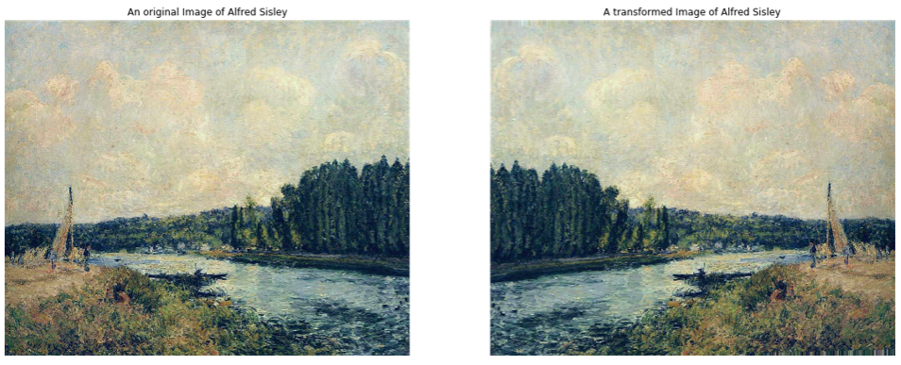
DATA AUGMENTATION
Used ImageDataGenerator
Batch size = 16
Train Input Shape = 224, 224, 3
Number of classes = 11
Train: 3444 images (belonging to 11 classes)
Test: 855 images (belonging to 11 classes)
Train for 215 steps, validate for 53 steps

Slide 6
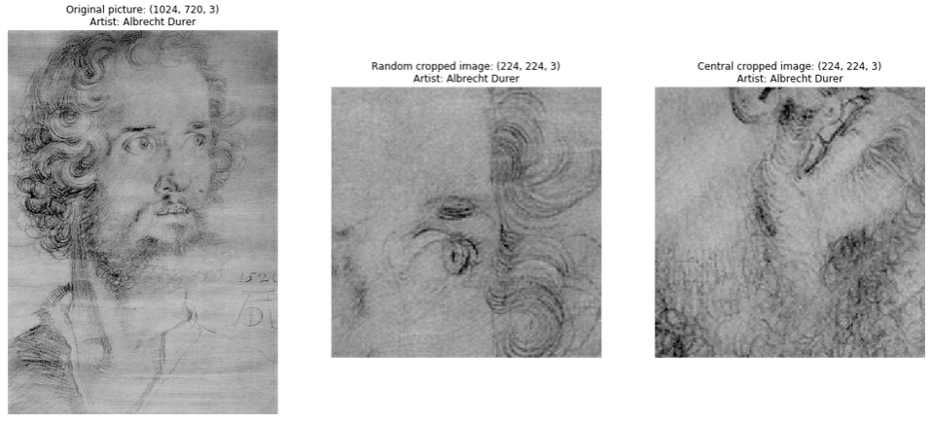
DATA AUGMENTATION – custom function
During training, pictures are randomly transformed:
Random cropped
Central cropped and randomly rotated

Slide 7
Convulsional neural network
the

Slide 8
Convulsional neural network MAIN PARTS
Convolutional Layer - extracts features from a source image and can help the machine to learn specific characteristics of an image.
Pooling Layer (Flatten Layer) - reduces the image dimensionality without losing important features or patterns.
Fully Connected Layer (Dense Layer) - the output of the convolutional layers is fed through one or more neural layers to generate a prediction

Slide 9
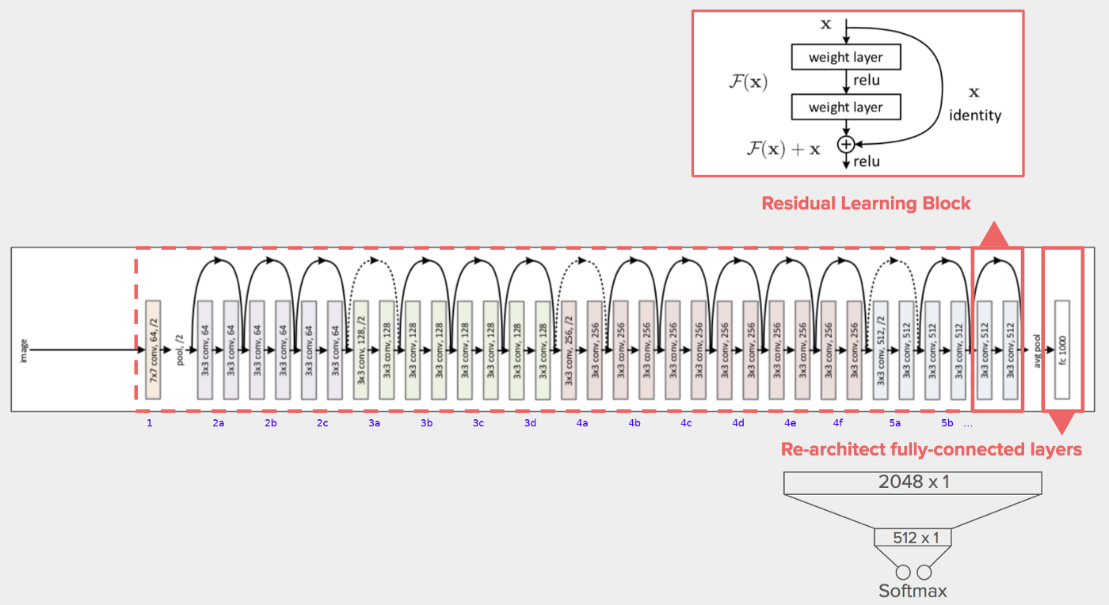
Resnet50 diagram
Pre-defined architecture as baseline
Pre-trained weights on ImageNet
Base Model – Transfer Learning

Slide 10
Layers
Flatten (Pooling Layer) - Flattens the input from matrix to vector and does not affect the batch size
01
Dense (Fully Connected Layer) - Each input node is connected to each output node.
02
Batch Normalization - Normalize the activations of the previous layer at each batch
03
Activation - ReLu
04
Dropout – drops a fraction of the neurons in order to prevent overfitting
05
EarlyStopping – halts the model's training once the model performance stops improving on validation dataset
01
ReduceLROnPlateau – reduces learning rate when a metric has stopped improving.
02
Callbacks

Slide 11

Conclusions
Accuracy
Loss
Confusion Matrix
Demo

Slide 12
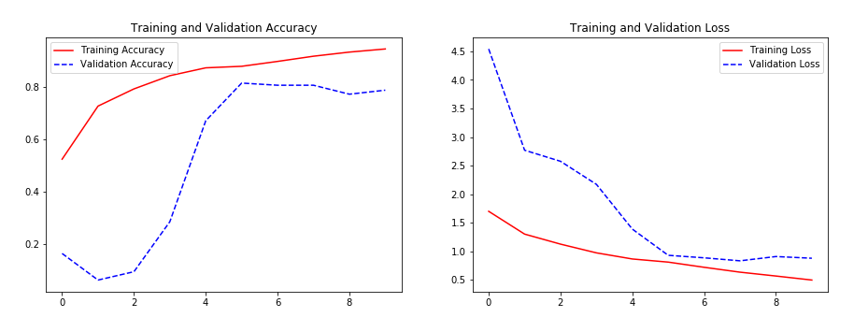

Slide 13
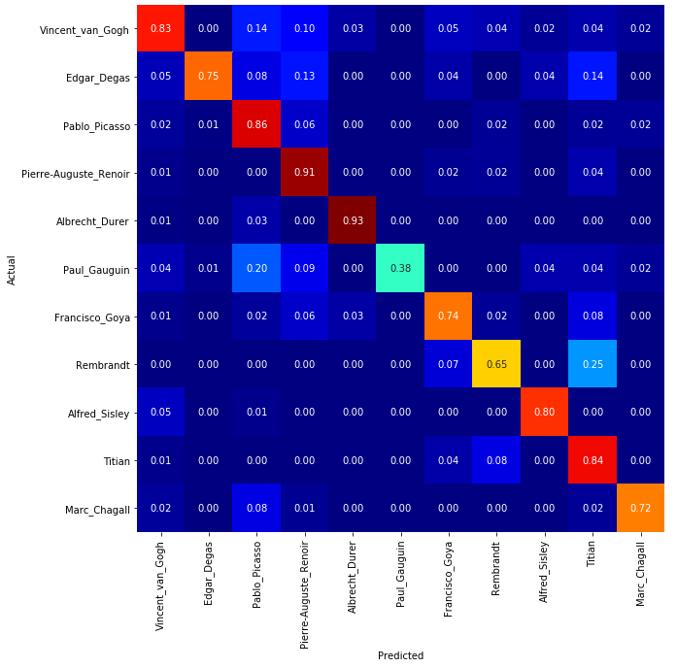
Confusion matrix

Slide 14
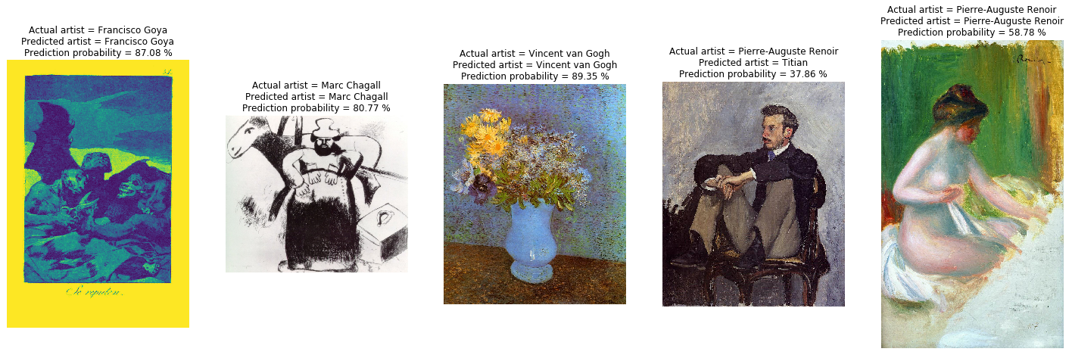
DEMO

